Slide 1
Education
Silvia Vidor – University of Trento
With contributions from: Alberto Lluch Lafuente (DTU), Fabio di Franco (ENISA), Fabio Massacci (UNITN, VUA), Carlos E. Budde (UNITN)

Slide 2
WP6 - Cybersecurity Skills and Capability Building

Slide 3
Main education objective of CS4E
“To define guidelines and tools that support the design of capability building instruments”
Examples:
Identification of cybersecurity knowledge units and curricula;
Specification of relevant learning objectives and competences;
Development of training and awareness activities;
Development of quality certification processes.

Slide 4
Some key questions we addressed
Which cybersecurity knowledge areas/units/skills can be taught?
In which areas/units/skills are we educating people?
How to choose knowledge areas/units/skills for a specific profile?
How should an education unit be designed and offered?
How does one assess and evaluate the quality of an education offer?

Slide 5
Which cybersecurity knowledge areas/units/skills can be taught?
We combined the ACM framework with some elements from the NIST framework.
This served well the purpose of mapping education programmes, identifying skills, etc.

Slide 6
In which areas/units/skills are we educating people?
We did a survey of ~100 MSc in Cybersecurity
Main goal: identify capacity building gaps
By-product: the online MSc Education Map
Education programmes were then invited to join the ENISA map.

Slide 7
How to choose knowledge areas/units/skills for a specific profile?
Main goal: identify skills and content of teaching modules for specific job profiles.
Methodology: use the CybserSec4Europe education framework and ask experts how relevant knowledge units are.
The result is a weighted importance of each unit, to be used as the basis for content design.
This methodology has been evaluated on 24 job profiles.

Slide 8
How should an education unit be designed and offered?
What else can we do beyond traditional education (classroom courses)?
Some education means we have looked at:
MOOCs: online (cf. COVID19), massive (scalable), asynchronous.
Cyber ranges: challenge-driven, based on teamwork, hands-on, interactive.
Security Serious Games: gamification-powered, fun, interactive.

Slide 9
How does one assess and evaluate the quality of an education offer?
Proposed quality criteria for MOOCs:
QC1 - Qualification of the Proposer
QC2 - Qualification of Participants
QC3 - Qualification of Instructors
QC4 - Examination and Credentialisation
QC5 - Course Evaluation
QC6 - Meeting Professional Expectations
QC7 - Course Structure, Content and Evaluation
QC8 - Course Platform and Channels
QC9 – Openness
QC10 - Ethics
QC11 – Privacy
QC12 - Utilising Cyber Ranges

Slide 10
Future Perspectives on Cybersecurity Education

Slide 11
Consolidating cybersecurity in Europe
Using the framework developed in WP6, a survey has been performed to verify which skills are considered important in cybersecurity for academia and industry.
There are critical skills that are not currently being taught by cybersecurity programs – e.g. Incidents & Continuity.
At the same time, there are critical mismatches between industrial and academic skills – with 7 out of the top 10 skills different between the two fields.

Slide 12
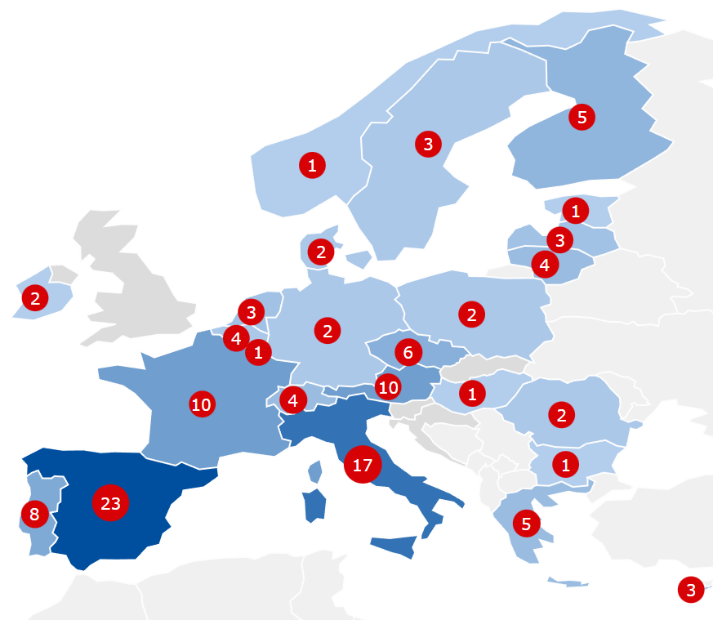
CyberHEAD
Crowd-sourced database of cybersecurity related education programmes:
largest and updated point of reference for citizens looking to upskill their knowledge in the cybersecurity field
started as collaboration between CS4E and Sparta in the CCN, now maintained by ENISA.

Slide 13
Thank you for your attention!
Silvia Vidor – silvia.vidor@unitn.it – University of Trento
https://cybersec4europe.eu

