Slide 1
Governance Design and Pilot
Natalia Kadenko, TU Delft N.I.Kadenko@tudelft.nl Michel van Eeten, TU Delft M.J.G.vanEeten@tudelft.nl

Slide 2
Challenges
Lack of cooperation between Member States, industries, and academia, leading to fragmented efforts in research and development (R&D)
Insufficient investment in cybersecurity
Increased demand for skills, know-how, and facilities, while access thereto is limited
Inconsistency of new policies and governance with the existing legal frameworks

Slide 3
Challenge accepted!
Goal:
We aimed to design a governance model to institutionalise sustainable development of the European cybersecurity community.
Means:
Stakeholder input collection and research (D2.1)
Validation of the assumptions on the governance structure (D2.2)
Further development of the governance model (D2.3)
Community setup assessment, maturity evaluation toolbox, policy recommendations (D2.4)
Solution: CHECKs (Community Hubs of Expertise in Cybersecurity Knowledge)
We developed, validated, and improved a flexible governance structure that has the potential to address urgent cybersecurity challenges through capitalising on the community-derived capabilities and ensuring robust cooperation.
Notes:
which are envisioned as environments for community-level research, innovation, and capacity building in cybersecurity. This concept answers concrete stakeholder demands and is based on requirements, empirical best practices, and stakeholder feedback.
The CHECKs are as such the low-level, easy-to-access points of accumulation of regional interests and information, and they can serve as accelerator to demands and problem identification as well as solution mechanisms.

Slide 4
D2.1 Governance Structure v1.0
D2.2 Internal Validation of Governance Structure
D2.3 Governance Structure v2.0
D2.4 Roadmap of the Set-Up of the NCC

Slide 5
30 November 2022
5
Notes:
5

Slide 6
D2.1 Governance Structure 1.0
01

Slide 7
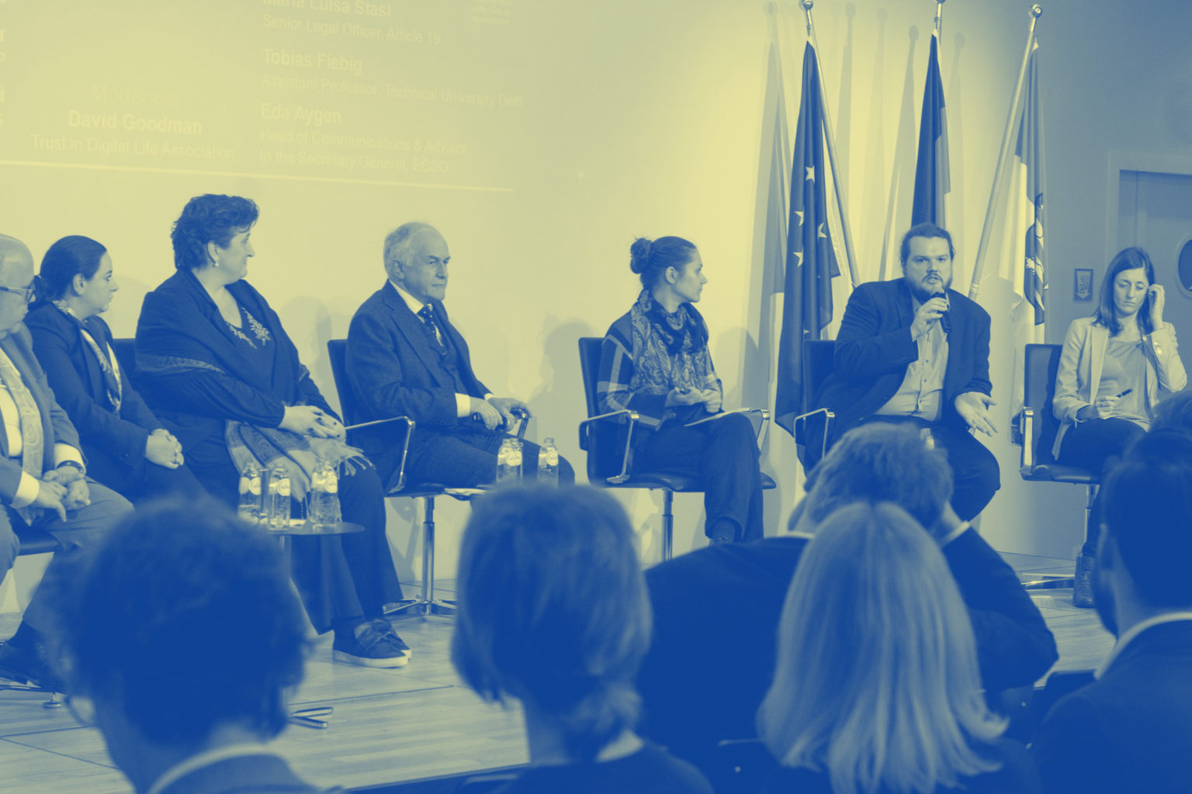
Notes:
Pre-covid…

Slide 8
Funding mechanisms unclear
Critique
EU competence: Steering vs supporting roles
The Competence Centre
Insufficient democratic representation, concentration of power with EC
Facilitates, coordinates
nurtures
Too many tasks for too few substructures
the form of cooperation is not properly defined
Financial contributions need clarity
sends 16 members to the Advisory Board
supports
(contractual agreement)
European Commission
supports
accredits the entities as members of
assessment
Which form: EU Agency? How will the cooperation with the other EU agencies look like?
accredits
The Competence Community
The Network
accredits (as a national contact point)
What will selection procedure look like? Cooperation with Network and Centre? Cooperation between the members?
National Coordination Centre
8
8

Slide 9
Stakeholder Council
complementing/ substituting Advisory Board
1/3 Community, 1/3 CHECKS, 1/3 SE representatives
fixed seats for the certain groups
(e.g., civil society, data protection)
Other substructures
The Competence Centre
Vibrant EU
Cybersecurity
Community
Facilitates, coordinates
Governing Board:
strategic decisions
Executive Board:
lower-level decisions
More balanced voting rights distribution
EP inclusion
Stakeholder Environment
Informational input
-partners
-areas of competence
accreditation
Informational input
The Competence Community
The Network
National Coordination Centres
Community Hubs of Expertise in Cybersecurity Knowledge (CHECKs)
Linking and integrating stakeholders
Bringing funds to the research projects
Promoting and facilitating scientific activities
9
9

Slide 10
Main findings:
Input: stakeholder interviews, workshops, surveys, collaboration research
Cybersovereignty, independence, and control
Focus of the NCC network should be broader than only stimulating R&D, and also include capability-building and policy interventions
Combination of a hierarchical and a network model
Open to a diverse set of actors, initiatives and collaborations
Facilitating collaboration between academia and industry
Address the lack of focused investment
The synergy between formal and informal, top-down and bottom-up structures can be achieved by integrating informal structures, thus leading to a more efficient stakeholder engagement throughout all societal levels. Transparency is another key element for facilitating trust in an organization

Slide 11
Main findings (2):
1. Enabling innovation by facilitating a tight collaboration between industry and academia.
2. Streamlining investment and funding processes to facilitate innovative research.
3. A focus on distributed capacity-building leveraging existing centres and competence hubs.
4. An overarching bottom-up approach, which does not suffocate those existing structures, but instead nurtures and integrates them, to generate the NCCC as an emerging property of these Centres.

Slide 12
D2.2 Internal Validation of Governance Structure & D2.3 Governance Structure 2.0
02

Slide 13
Model presented in D2.1 → validated in D2.2
Real-life scenario, CHECK-T
Interviews with all types of stakeholders in CHECK-T → clustering and analysis of responses and comparison between different approaches
Four “pillars”: Governance and structure, objectives and performance indicators, business model, stakeholders
Notes:
namely with cybersecurity stakeholders in Toulouse in an entity named Community Hubs of Expertise in Cybersecurity Knowledge (CHECK Toulouse). Validation follows a bottom-up approach, based on interviews with all types of stakeholders in CHECK-T, and posterior analysis of findings

Slide 14
The simultaneously developed deliverable D2.3 offered a continuation of the analysis of existing governance structures started in D2.1 and the first results from the prototyping activities for CHECKs, involving CHECK-T and the Region of Murcia CHECK, and analysed further governance design aspects for CHECKs like the organizational structure, membership, tasks, funding and relationship to other institutions
The team involved with the implementation of CHECK-T also conducted interviews with stakeholders in order to learn about their needs and requirements regarding CHECKs
What makes CHECKs attractive for them to participate?
Notes:
ese results, together with findings from the observation of possible changes in the governance structures of organisations already addressed in D2.1 and the observation of the progress made in the legislative process, are the basis for the improvement of the governance structure that had been proposed in D2.1, with the main focus being on the development of a detailed governance approach for CHECKs.

Slide 15
Validation of the model
Findings from the stakeholders
Findings from the observation of possible changes in the governance structures of organisations already addressed in D2.1
The observation of the progress made in the legislative process
Improvement of the governance structure that had been proposed in D2.1, with the main focus being on the development of a detailed governance approach for CHECKs

Slide 16
Vision: CHECK-T and its context
Funding opportunities
1st hub of cyber network
Investors / local funding actors
Services
Need
Connect
Economic Development actors
Offer
CHECK-T
Utilisateurs finaux (grabds groupes, PME / Startups, groupements de citoyens
End Users (big and small busineses, citizens groups)
Awareness / Acculturation
Connect
Show value
Poles and Clusters, Eco Dev agencies, local authorities..
Use Cases, Demonstrators, Simulation platforms
Facilitate
Facilitate
ROI, Market access
Technological Centres, Solutions providers
Technical solutions providers

Slide 17
Main findings (1):
Main findings of D2.1 confirmed and elaborated in more detail
Stakeholders consider the concept of CHECKs matching their needs and requirements
Willing to contribute to European cybersecurity as members of the Community
At least two types of CHECK could exist, depending on its financing and business model, for the similar types of services
- An economic actor in the cybersecurity landscape, sustained by a sound business model;
A part of the public administration and financed as a public good.
Notes:
Dif hubs dif services, related to the economic development of a region, country, or specific sectors, which should be done in close partnership with solution providers and the research and higher education communities. activity of CHECK could be to provide the community-based assessments, whether these are for products (e.g., MOOC), services (e.g., training) or organizations (e.g., new members). CHECK networks, could be a basis for the EU Competence Community, the flexible governance model should align EU, national and regional interests, but also common research agendas. Interface mechanisms avoid overlap make periodic alignments

Slide 18
Main findings (2):
The need to have a coherent cybersecurity ecosystem approach in Europe, with many interconnected CHECKs or other similar structures, as well as organisations such as ECSO.
These structures should not only “co-exist” but should rather acknowledge the existence of different CHECK types, that can be coordinated at the national level, as well as EU level, and should form a network of decentralized networks
Several rules for membership and representation were suggested including different statuses, such as full member, associated member and observers.
Membership at CHECK (regional or sectorial/functional) could be decided upon assessment of the commitment and according to the voting process.
Notes:
the need to have a coherent cybersecurity ecosystem approach in Europe, with many interconnected CHECKs or other similar structures, as well as organisations such as ECSO. These structures should not only “co-exist” but should rather acknowledge the existence of different CHECK types, that can be coordinated at the national level, as well as EU level, and should form a network of decentralized networks.

Slide 19
D2.4 Roadmap of the set-up of the NCC
03

Slide 20
Created maturity assessment toolbox
Presented an up-do-date overview of best practices for NCC and community setup
Conducted and updated legal analysis of the Regulation to understand the community-building status and incentives
Highlighted the state of the European cybersecurity community (four pilots, ECSO)

Slide 21
Findings
Institutionalise the Cybersecurity Competence Community
Use CHECKs to organise the Community, in order to address the existing challenges, while providing flexibility
Dedicate funds to capitalise on the existing community connections and networks.
Notes:
It is key that the National Coordination Centres have a systematic approach to registering communities and hubs.
The benefits and added value for possible members to get acknowledged as members of the Community through the application and registration procedure should be made clear.
This concept answers concrete stakeholder demands and is based on requirements, empirical best practices, and stakeholder feedback. The existing diversity in the Member States and their connection to the NCCs and to the Community can be integrated through CHECKs (thus resulting in complementary approaches for addressing the same mission).

Slide 22
What’s next?

Slide 23
CHECKs (Community Hubs of Expertise in Cybersecurity Knowledge)
A flexible organisation, accounting for the needs of the local community and creating real added value, combined with requirements for the CHECK establishment
Engage the stakeholders, provide the contact channels, share best practices
Promoting the already existing and functioning structures, especially at national level, while actively pursuing the aim of a pan-European community
Community-level cybersecurity hubs which should enable collaboration between industry and academia, bring market security innovations, and help build capabilities in the area
Provide scientific and industrial collaboration framework
Build up community resilience
Through the bottom-up engagement, ensure transparency and trust
Shortening the chain between decision-making and existing needs on the ground
The governance model would benefit from accompanying European cybersecurity funding mechanisms in the next decade to increase funding and investment to build a pan-European community

Slide 24
Community
The majority of relevant stakeholders are involved in the cybersecurity ecosystem through the four pilots and ECSO, forming an ecosystem with different focusses, maturity stages and objectives.
Therefore, dedicated funds should be provided, for example, under the Horizon/Digital Europe Programmes, to deepen the cooperation and coordination of such stakeholders, alongside dedicated funds to set up CHECKs in all Member States.

Slide 25
Thank you! Questions? ☺
Natalia Kadenko n.i.kadenko@tudelft.nl

Slide 26
Studied diverse governance approaches
Collected input from more than 90 stakeholders from different
groups and countries through interviews, surveys, workshop (D2.1)
Used quantitative analysis to examine collaboration
Learned from the MOOC governance case
Created impact through the CHECK setup process in Spain and France
Improved the bottom-up concept: different types of CHECK could exist, depending on its financing and business model (D2.2)
Community engagement through the workshop and cross-pilot collaboration
Conducted and updated legal analysis of the Regulation Proposal to understand the requirements and possibly expand the existing vision (D2.3)
Conducted and updated legal analysis of the Regulation to understand the community-building status and incentives (D2.4)
Created maturity assessment toolbox (D2.4)

