Slide 1
Dissemination, communication & exploitation
David Goodman, Trust in Digital Life Association
2 December 2022

Slide 2
Agenda
Website & social media
News posts
Branding
Dissemination / communication activities
Events, webinars
Publications
Summer schools
SME awareness
Awareness effectiveness
Supply chain
Exploitation strategy
Policy recommendations
Beyond Momentum!

Slide 3
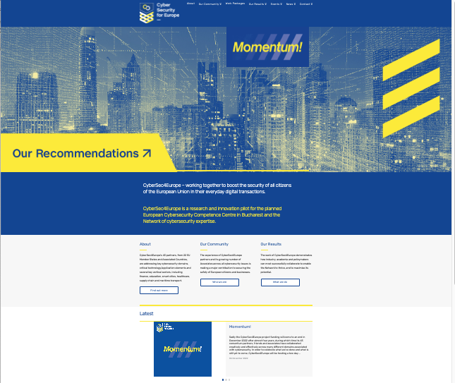
Website
Maintained on a daily/weekly basis to stay fresh
Profile of consortium and associate partners
Profile of the wider community
Project deliverables and results
Project event repository
A community events calendar
News posts, press releases
Scientific articles
Access to project YouTube channel
An interactive map for education providers plus
surveys etc.

Slide 4
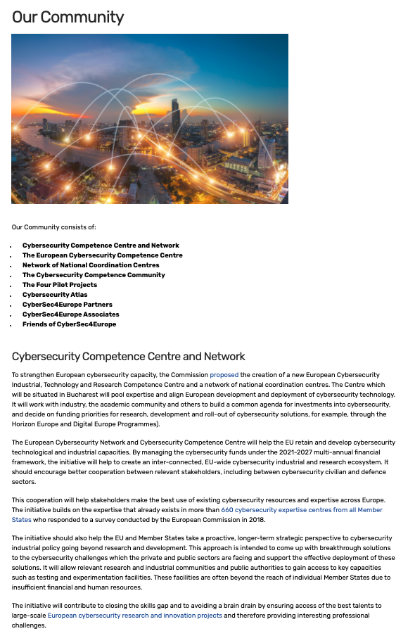
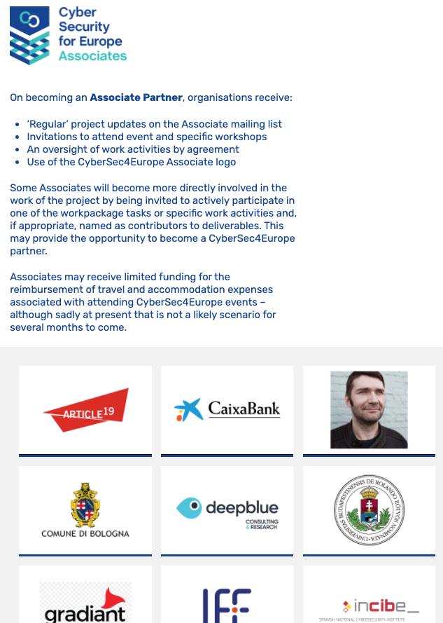
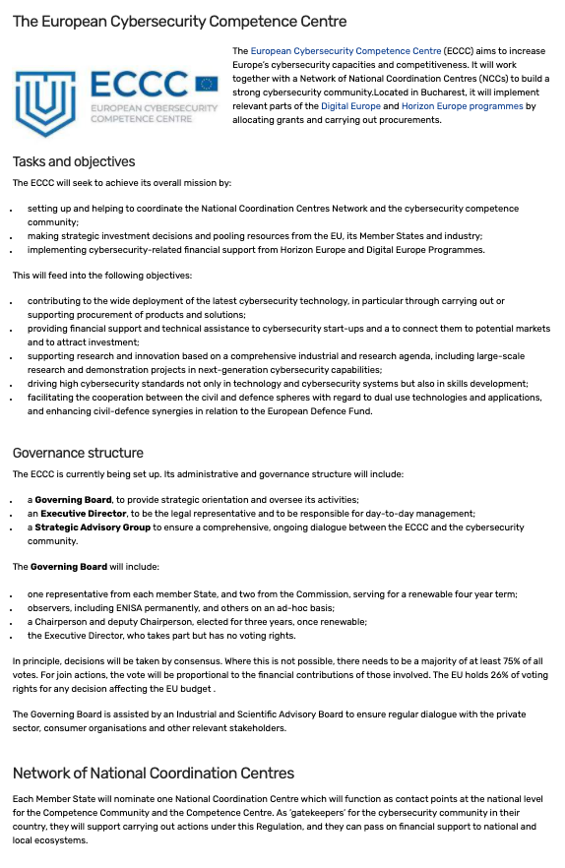
Our community
Information about the wider cybersecuritycommunity
News bulletins sent to Friends and Associates on a regular basis

Slide 5
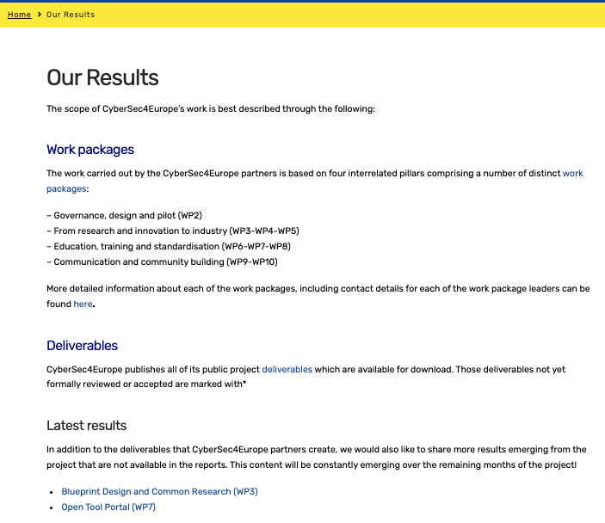
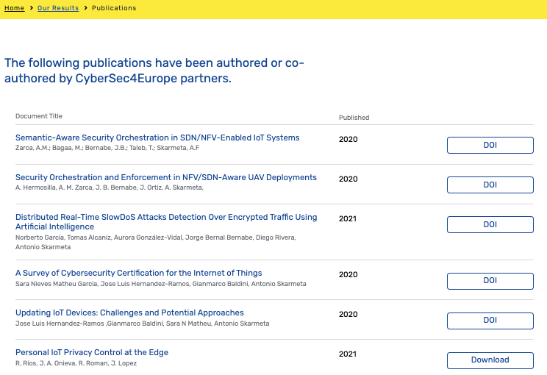
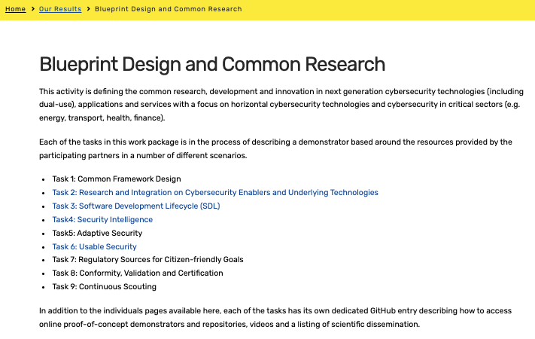
Our results
Access to all project results including deliverables, publications and much more!

Slide 6
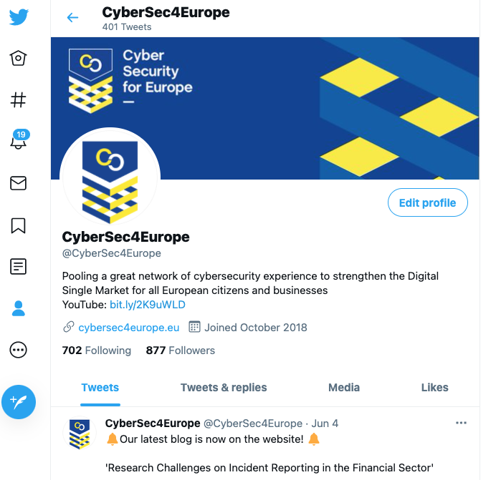
Social media
All news blogs posted on the website also get communicated on social media, hyperlinking Twitter and LinkedIn to direct viewers to the site.
Twitter: 1090 followers
LinkedIn: 777 followers
A steady increase every month
Use of personalised images and GIFs further establish the project brand

Slide 7
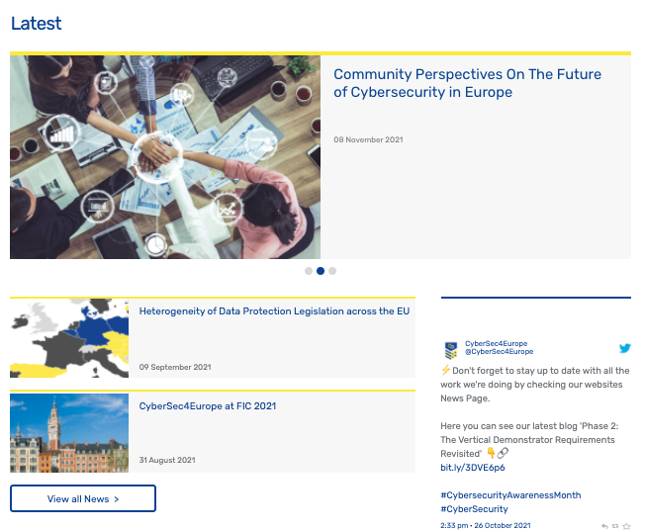
News posts
In addition to highlighting general cybersecurity news, such as events, workshops, summer schools that consortium partners either organise or participate in, we schedule weekly blogs from partners who are progressing or submitting deliverables – or have other news, insights and opinions to share.
Each blog is featured on the website, and posted on LinkedIn with accompanying tweet

Slide 8
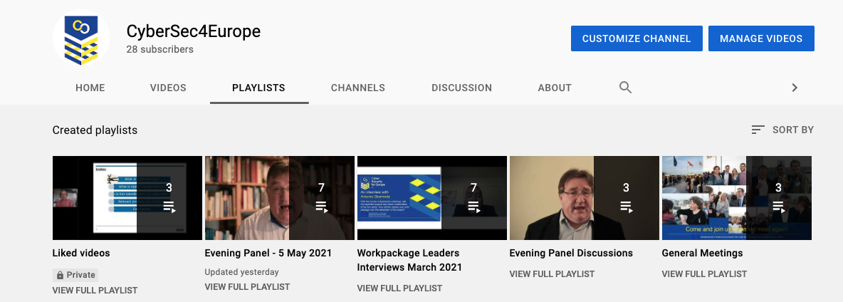
YouTube channel
Two series of interviews with work package leaders, who outlined the objectives, ambitions and lessons learnt in their work area
Also:
recordings of evening panel discussions and webinars
videos demonstrating software assets by task
a CyberSec4Europe promotional video

Slide 9
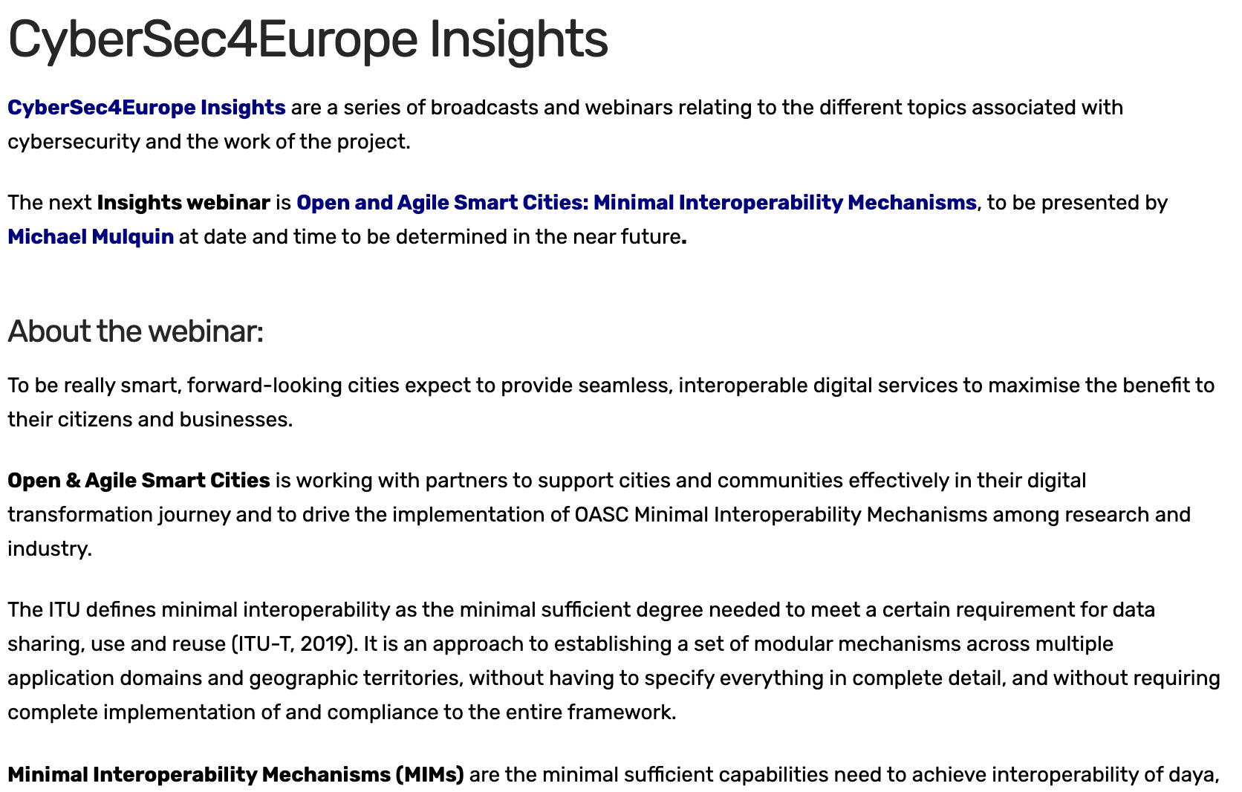
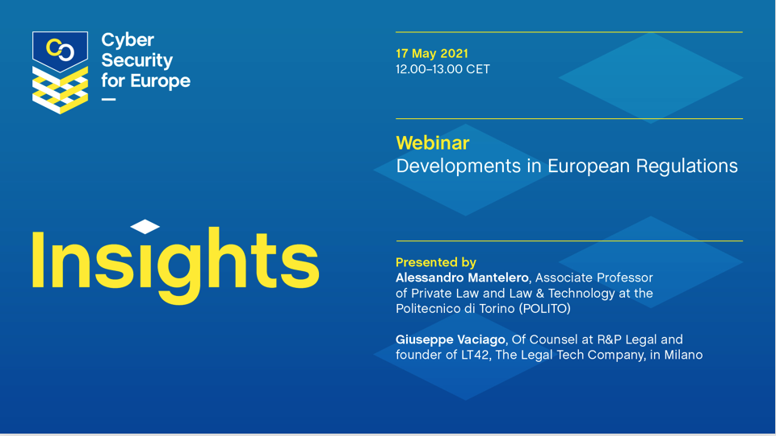
Insights
Insights are a series of webinars mostly led by the standardisation team to date, with post-event recordings available.

Slide 10
Dissemination and communication reporting
Each partner uses a ‘Partner Activity Reporting’ template, to maintain a record of their activities in the following categories:
Dissemination / outreach / awareness / communication activities
Community interactions
Standardisation activities
Publications
Exploitation plans
Recommendations
Attendance at a single event could fall into one, two or three different categories depending on the level and type of participation

Slide 11
Brand development

Slide 12
Brand development

Slide 13
Brand development

Slide 14
Brand development

Slide 15
Brand development

Slide 16
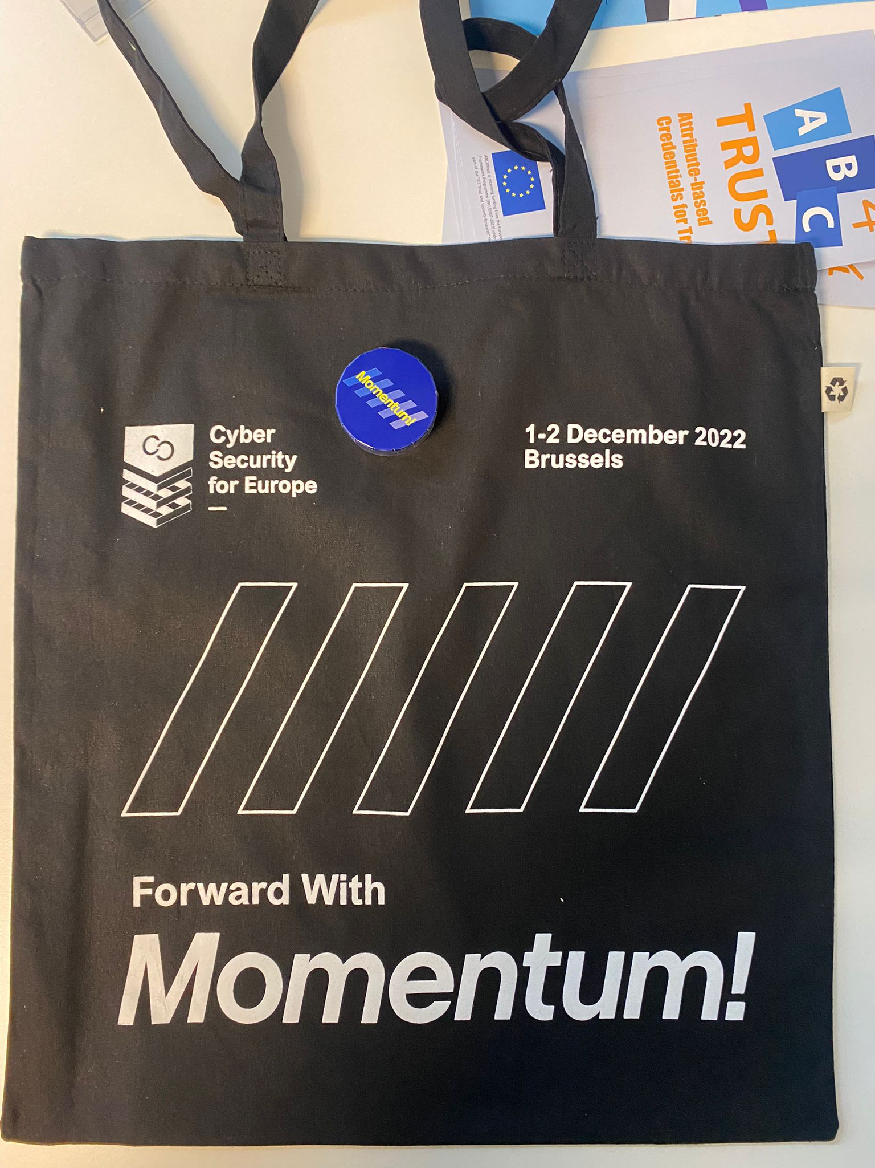
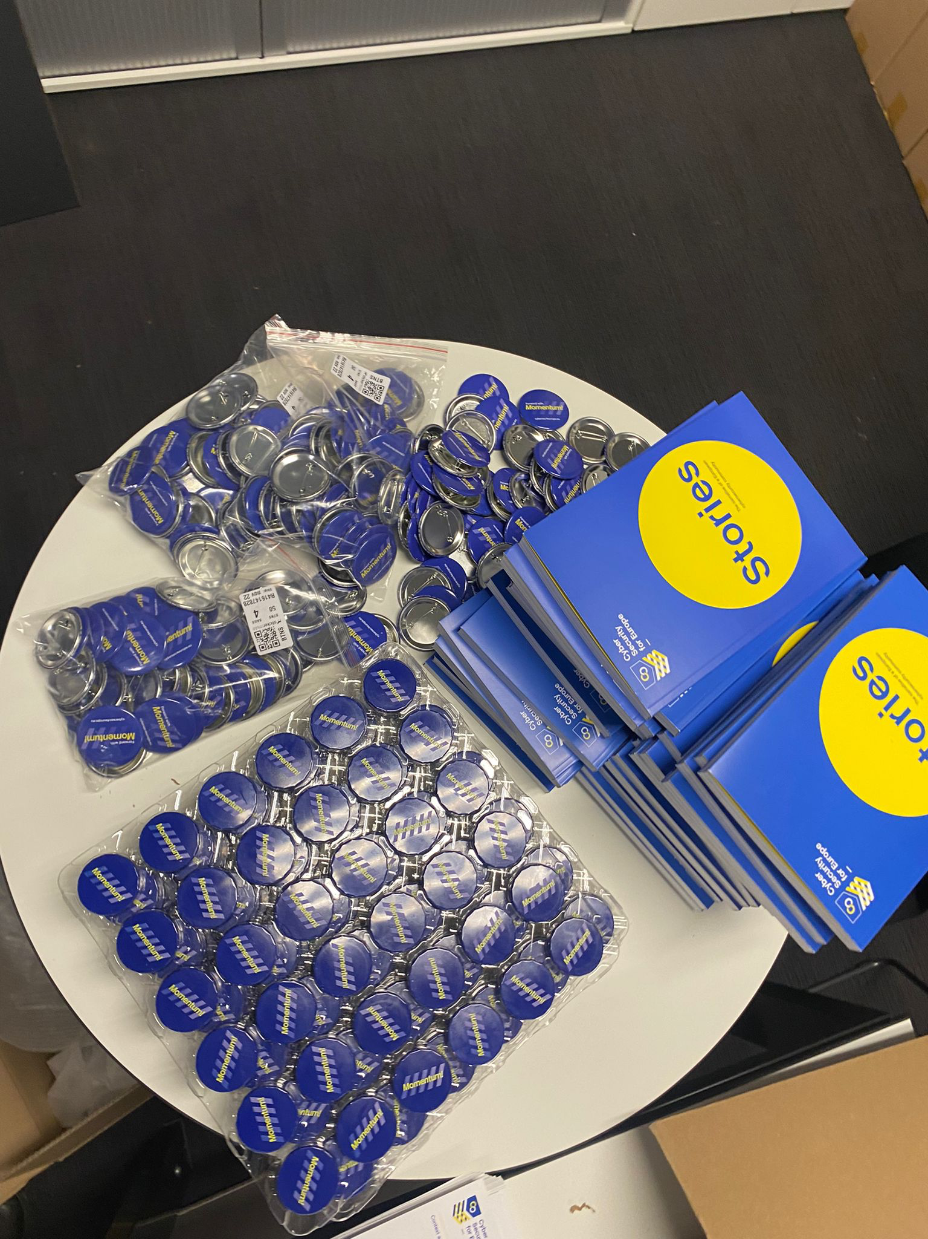
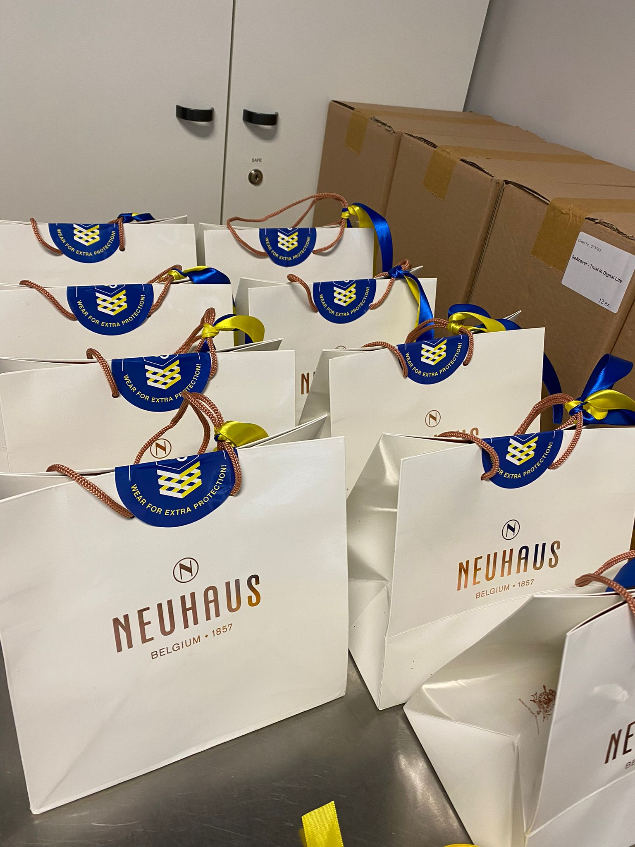
Brand development

Slide 17
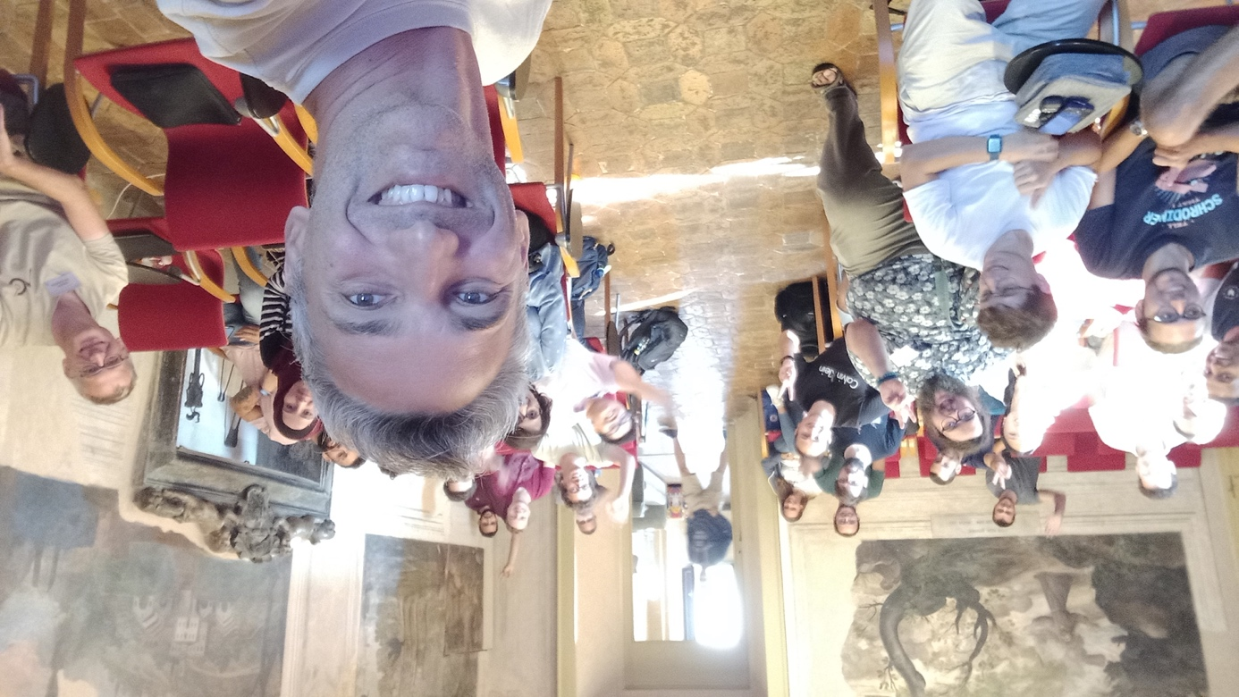
Summer schools
CyberSec4Europe project partners are organisers, committee members or presenters at cybersecurity summer schools across Member States, limited due to the pandemic restrictions
CyberSec4Europe project partners also author or co-author articles in published journals and reviewed publications and presentations are listed on the website and on the EC portal
Smiling faces at FOSAD 2022

Slide 18
Raising awareness
Three sets of activities:
SME Cybersecurity Awareness Program – three reports including sources of cybersecurity awareness resources and materials that can be useful for SMEs.
Supply Chain Security Recommendations – two reports constructed on a narrative based on project-wide supply chain-related activities
Awareness Effective Study – three reports proposed metrics for the evaluation of a cybersecurity awareness program on the basis of a systematic literature review

Slide 19
SME cybersecurity awareness
A survey and analysis of cybersecurity awareness programmes, both free and commercial, with particular relevance to SMEs
A survey of SME representative bodies and statutory bodies with responsibility for economic well-being of SME sector
Finland, Greece, Italy, Norway, Poland, Slovenia, Spain, Sweden, Switzerland, UK
A policy recommendation for tackling the problems associated with massive outreach

Slide 20
SME cybersecurity awareness
Cybersecurity awareness raising challenges
Communication channels
Focus on non-IT SMEs
Proposed actions:
Voluntary participation
Enforceable measures
`National or supranational directives
SME survey
Data collection and analysis
Recommendations
Collaboration with other projects:
Cyber GEIGER (Cluj Napoca)
MIND4MACHINES (VTT)
Outreach to:
National SME federations
National / international trade associations
Local Chambers of Commerce
Investigation of:
Banks
Investors
Accountants
Insurance companies

Slide 21
Supply chain security recommendations
Two reports providing a narrative derived from the supply chain-related activities across the project, primarily road mapping, the demonstrator use case and education.
It also includes a summary and analysis of supply chain regulatory developments in 13 different forms of legislation from the perspective of supply chain and SME impact.
And we also collaborated on a video …

Slide 22
Supply chain security recommendations
Introduction
Objectives: the interpretation and broad evaluation of project work including sustainability
Audience
Challenges (from roadmapping)
Opportunities (from roadmapping)
Evaluation of results (from demonstrator use case)
Training and education impact (from education / cyber ranges)
Impact of new legislation (NIS 2.0, Cybersecurity Strategy et al)
Recommendations (general and specific)

Slide 23
Awareness effectiveness
Three reports looking at research into how to measure the effectiveness of awareness programmes, based on a systematic literature review
The latest report uses an expert panel to determine the final list of factors and other findings to elicit the most important factors and also to validate them for relevancy and applicability.

Slide 24
Exploitation and innovation
Three reports consisting of progress made in evaluating:
Exploitation: listing responses from all 43 project partners
Joint exploitation: broken down by domains
Sustainability: based on strategic input, technical collaboration, communications and networking
Innovation: examples of CyberSec4Europe innovation based on asset maturity and potential real-world impact

Slide 25
Exploitation and innovation
Objective:
An initial collection of all partner exploitation plans after 18 months and then again closer to the end of the project
A methodology for assessing innovation and key exploitable results
Identification of value propositions to provide criteria for filtering
Output
A review of all assets, scored based on value propositions
Presentation to a jury
Reduced to a small number of key exploitation candidates to be showcased at Momentum!

Slide 26
Exploitation and innovation
Proposed value proposition parameters:
Technical readiness level
Marketing readiness level
Novelty or innovation level
Networking effect (e.g., threat intelligence sharing, value increase if part of a consortium, externalities, certification scheme etc)
Reusability/transferability across sectors
Affordability
Sustainability (e.g., how much is needed for further investment, maintenance of code etc)
Green credentials (e.g., how does this benefit climate, use of power etc)

Slide 27
Exploitation and innovation
Latest partner exploitation plans collected during 2022
An independent, external two person jury selected:
Stelian Brad, Cluj IT Cluster and Stefan Bumerl, CRYPTAS it-Security GmbH
Next steps:
About half of the assets were scored against a set of value propositions and filtered down to 13 and the list handed to the jury
Results:
Top six results were identified and showcased at Momentum! with a view to identifying two to take forward to the Horizon Results Platform
All exploitation plans to be highlighted through the website and in the report

Slide 28
Exploitation and innovation
Congratulations to:
SecCerts, Masaryk University
EBIDS, Consiglio Nazionale delle Recerche (CNR)
But of course all CyberSec4Europe partners are winners …. 🍾🍾👏👏
Many, many thanks to Stelian and Stefan for your dedication and professionalism in engaging with us over the last month and your stellar evaluation review at Momentum!

Slide 29
Policy recommendations
Over three reports, selected policy recommendations from the project were presented in a way that can be easily understood and used by interested stakeholders, especially policymakers.
The task follows a two-pronged approach:
Reactive: Cyber4Europe partners received and accepted invitations to provide recommendations in several forums, including workshops, concertation meetings, EU-level organisations such as ECSO, ENISA, the EDPS etc.
Proactive: project partners acknowledged that much of the work already performed in the project may create contributions that are practically policy recommendations.

Slide 30
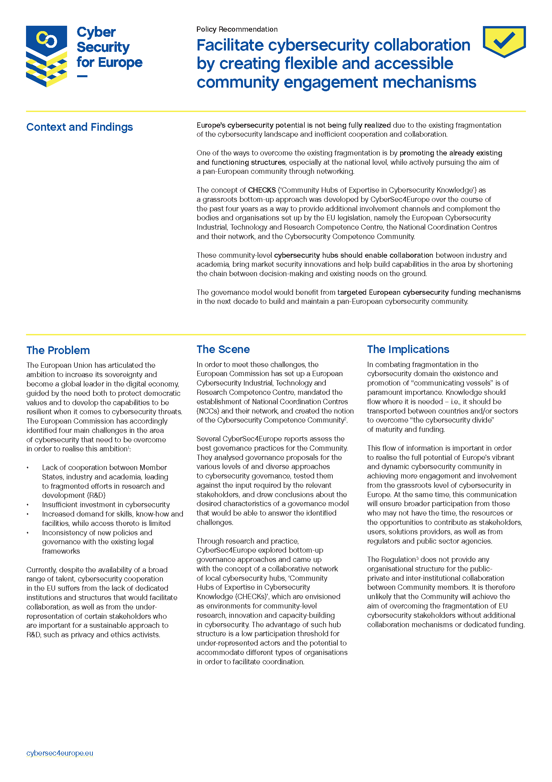
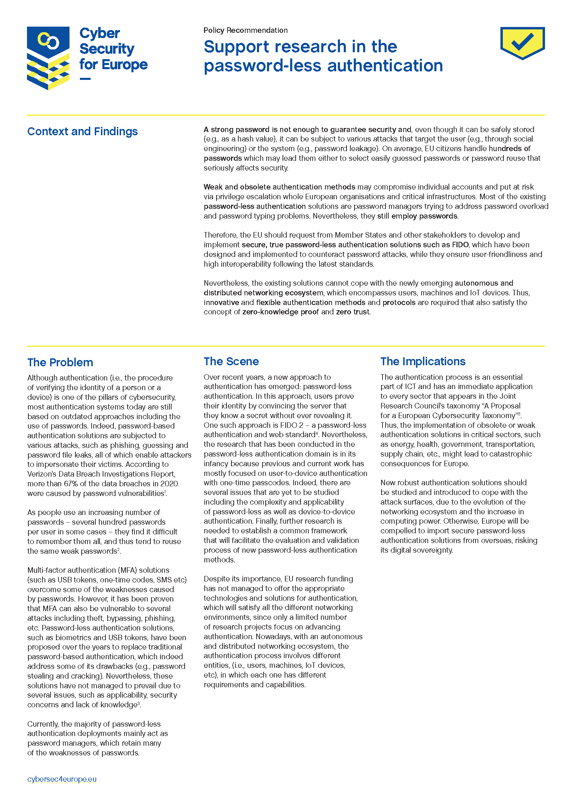
Policy recommendations
The three reports culminated in a number of policy briefs derived from individual work activities and/or common themes, targeting appropriate policymakers
Four of these policy briefs are available at Momentum!

Slide 31
Summary
Managed:
project website & social media
weekly news posts/blogs
branding for events, other purposes
Collected project partner:
dissemination / communication activities
scientific articles
Organised events and webinars
Reported on summer schools involving or organised buy partners
SME awareness programmes analysis and recommendations for better outreach based on survey in different. Member States – as well as awareness effectiveness
Supply chain security recommendations, particularly for SMEs, also based on supply chain work across the project
Exploitation and innovation strategy and output from all partners
A series of policy recommendations based on project findings

Slide 32
Beyond Momentum!
The website and social media accounts to be maintained for five years
Initiatives to maintain the community after the end of funding:
To track the fortunes of the exploitable results
An opportunity:
to pursue areas of ‘unfinished business’ – for example, SME awareness
to explore new areas that the project was not able to address
to collaborate again!

Slide 33
Thank you to all our colleagues for collaborating and communicating with us!
David Goodman
david@trustindigitallife.eu

