Slide 1
Roadmapping
Evangelos Markatos, FORTH

Slide 2
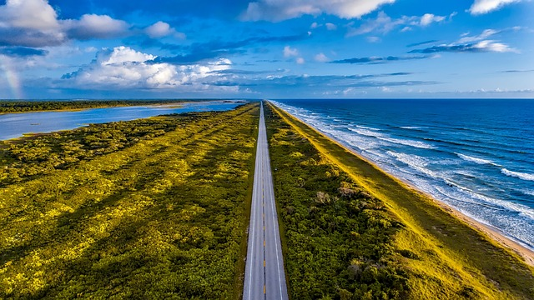
Contents
What is roadmapping?
Is cybersecurity a new problem?
What have we done?
The Blue Book
Summary

Slide 3
Contents
What is roadmapping?
Is cybersecurity a new problem?
What have we done?
The Blue Book
Summary

Slide 4
What is roadmapping in research?
A kind of prioritization
List the areas that are important in cybersecurity
We focus mostly on research. That is
we list the research areas that are important for cybersecurity
we start working on them
we encourage the rest of the community to work on them as well

Slide 5
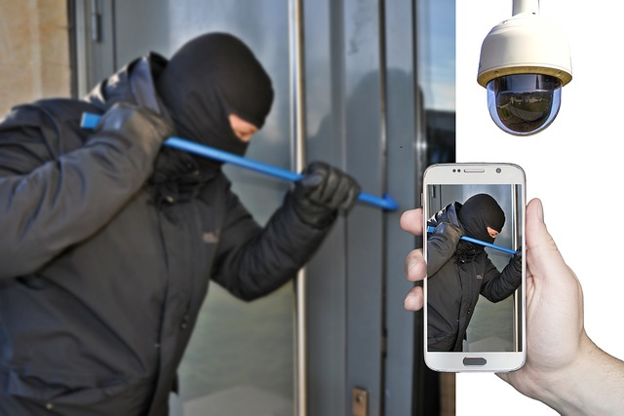
Why do we need roadmapping?
Cybersecurity is an old problem?
Right?
40-50 years old! Right?
What do we need to map now?

Slide 6
Contents
What is roadmapping?
Is cybersecurity a new problem?
What have we done?
The Blue Book
Summary

Slide 7
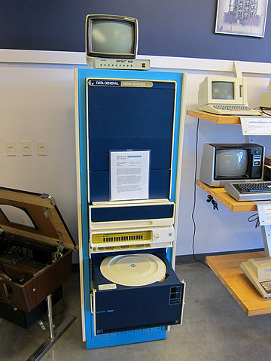
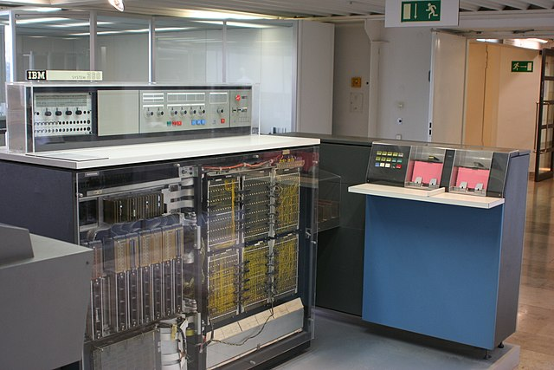
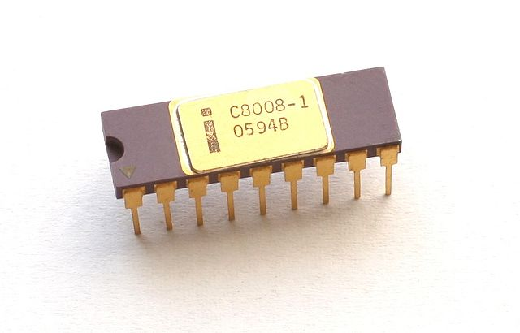
A trip down memory lane: 50 years ago - 1972
Mainframes were operating
Minicomputers were being sold widely
The C programming language was released
The 8008 microprocessor was released
By Jeff Keyzer from Austin, TX, USA –
Goodwill Computer MuseumUploaded by PDTillman, CC BY 2.0,
https://commons.wikimedia.org/w/index.php?curid=13025535
By Konstantin Lanzet - CPU Collection Konstantin Lanzet
Camera: Canon EOS 400D, CC BY-SA 4.0,
https://commons.wikimedia.org/w/index.php?curid=5694177
By Ben Franske - DM IBM S360.jpg on en.wiki, CC BY 2.5, https://commons.wikimedia.org/w/index.php?curid=1189162

Slide 8
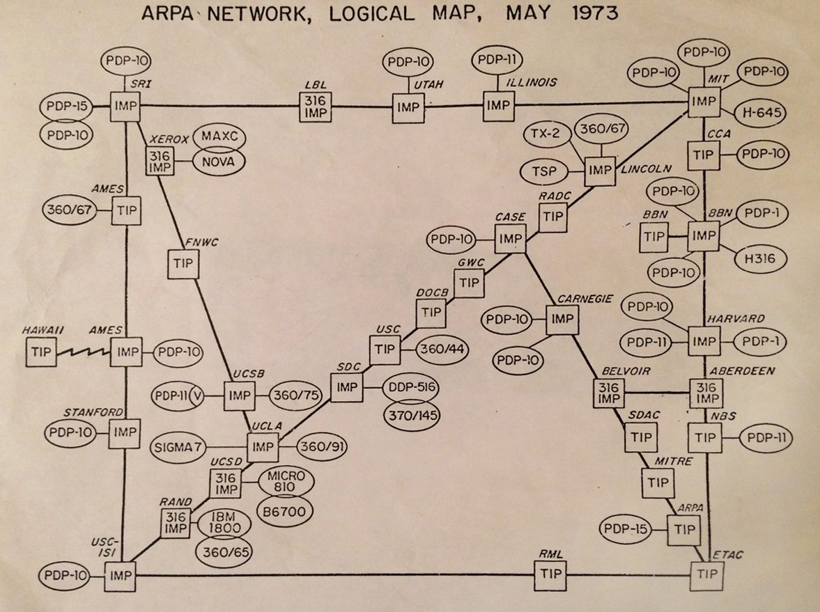
50 years ago we had networks
The Internet (ARPANET) in 1973
Source: By ARPANET - ARPANET, Public Domain,
https://commons.wikimedia.org/w/index.php?curid=54039329

Slide 9
So, 50 years ago
We had computers
Mainframes, mini computers were being sold, micros were starting to appear
We had vulnerable programming languages
The C programming language was there
Buffers were there - buffer overflows could happen
We had networks - the Internet
It was called ARPANET, but still…
We had software
Did we have any cybersecurity issues?

Slide 10
Cybersecurity in 1972
Cybersecurity in 1972
Existed but
Not a major problem
Because:
Closed Community
mostly academics had access
Boring applications
mostly scientific applications – numerical analysis
Compromised computers did not have a lot of value
No data
No financial value
Small scale:
just a few tens of nodes

Slide 11
So
So, because cybersecurity was not a major issue 50+ years ago
The Internet was not designed with security in mind
Small academic community
Restricted physical (and virtual) access

Slide 12
The situation did not change
For 25 years computers and the Internet kept on being
Boring
Mostly scientific applications
Closed community
Mostly academics had access
There was an occasional cyberattack
But people (out there) did not take notice…
They did not have an Internet connection
They did not have a Facebook account…
They did not have a smartphone…

Slide 13
An then.. Something changed!
Something changed!
People started connecting to the Internet
The ISPs started offering Internet connections
People of all realms – not only academics
Computers started storing data
Lots of data!
Interesting data!
Personal data: Email - gossip!
Financial data: Credit card numbers

Slide 14
And then things changed even more
People started doing
Online banking
Online stock market transactions
Online purchases
The money was on the Internet!
People started
Watching movies online
Reading newspapers online
Chatting with friends online
The advertisement money was on the Internet!

Slide 15
So…
Activities started migrating to the Internet
Entertainment, news, movies, television
Money started moving to the Internet
Web banking, stock market, on-line trading
and obviously
Crime started moving to the Internet
Fraud, thefts, phishing, attacks, money laundering, …

Slide 16
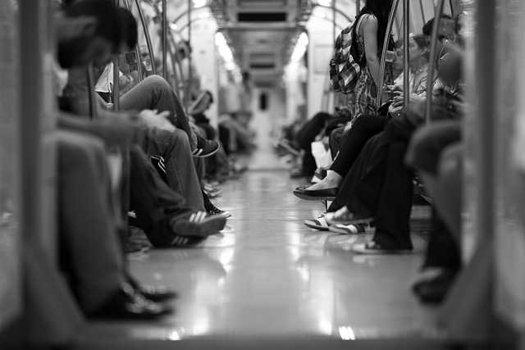
The result
We had an Internet designed for a small community of academics
Who knew and trusted each other
Being used by
Billions of people who
did not know each other
did not trust each other
may be hostile to each other

Slide 17
Now …we need to address the cybersecurity problem
We need to understand
The new types of attacks
i.e. What can attackers do with the Internet
What are the new attacks they can invent
What is the impact of these attacks
What kind of research can be done in order to
Mitigate these attacks
Reduce their impact

Slide 18
Contents
What is roadmapping?
Is cybersecurity a new problem?
What have we done?
The Blue Book
Summary

Slide 19
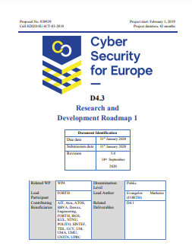
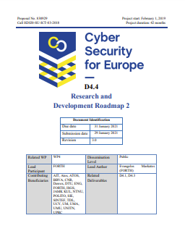
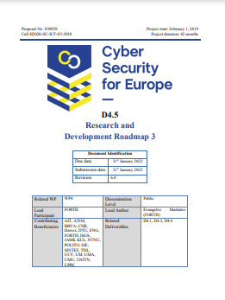
What have we done?
Three yearly roadmaps
to guide our work

Slide 20
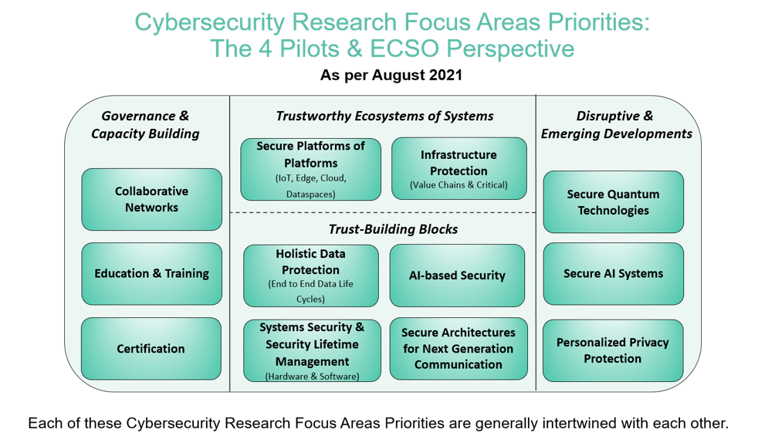
What have we done?
Participated in the Roadmapping Focus Group
We (the four pilots plus ECSO)
produced a set of priorities in cybersecurity
In collaboration with the cybersecurity ATLAS

Slide 21
Contents
What is roadmapping?
Is cybersecurity a new problem?
What have we done?
The Blue Book
Summary

Slide 22
Research Horizon Roadmap The “Blue Book”

Slide 23
What is it?
A roadmap for the future
Lists important cyber security research problems
Also lists Grand Challenges
i.e. Problems that are very difficult (and very important) to solve
Need 100s of millions of euros
And comparable person power

Slide 24
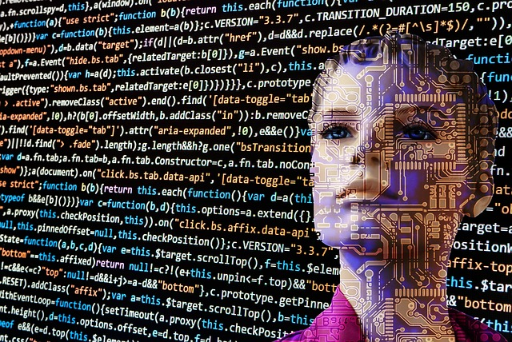
Grand Challenges I
Make AI safe for people
Explainable
Understandable
Safe to use
Safe to trust
Diversity
Make sure it is trained on a variety of people (or data)
AI is being used to drive a variety of security decisions
Intrusion detection, anomaly detection, etc.
AI is the target of a wide variety of cyberattacks
To make it take the wrong decision

Slide 25
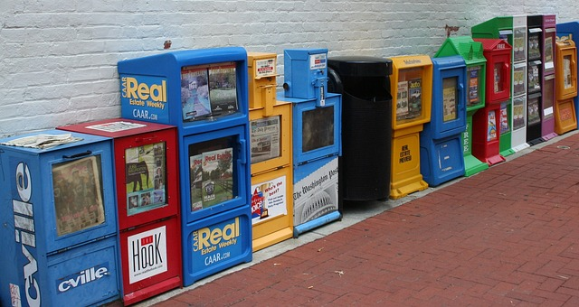
Grand Challenges II
If it can be done anonymously offline, it should be done anonymously online as well
In the offline world we do a lot of things (almost) anonymously
E.g. buy a can of soda, buy a newspaper, etc.
We pay cash – we do not reveal our name
This is not possible (today) online
We can not buy a newspaper
without revealing lots of personal information
e.g. name, address, credit card details
to lots of organizations
e.g. newspaper, credit card company, courier, trackers on the web page, etc.

Slide 26
Grand Challenges III
Make systems resilient under attack
Enhance general public awareness of cybersecurity
Give users assurance about the security of their devices

Slide 27
Research Areas
We also listed individual research areas
For each area we drilled down asking simple questions:
Who is going to be affected?
What is expected to happen? (if we do not address this area)
What is the worst thing that can happen? (if we do not address this area)
Research gaps
Problems that can be solved in one (or a small number of) HE projects
Example problems
Problems that can be solved in one

Slide 28
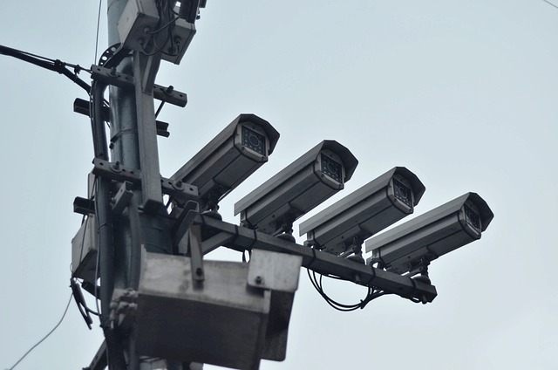
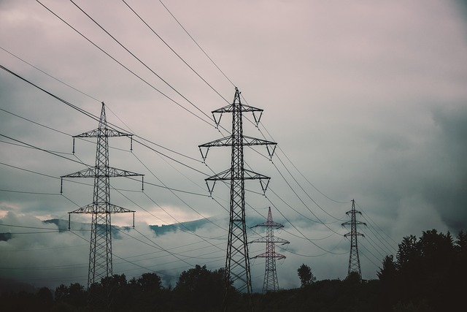
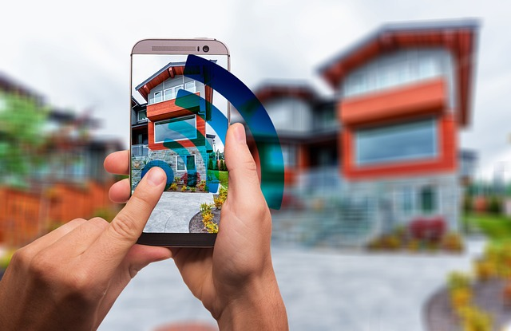
Research Areas
Anonymity
Machine Learning
Authentication
Security Awareness and Training
Trusted Execution
Privacy by Design
Critical Infrastructures
Metaverses
Malware
Software Life Cycle
Testing and Certification
IoT Security
Effective Threat Modeling

Slide 29
Anonymity
What is it?
Being able to operate without revealing our identity
Who is going to be affected?
All, and esp. vulnerable people (young ones, minorities, …)
What is expected to happen?
(Organized) crime will get (steal? purchase?) access to this information
Stalking (against victims that reveal their whereabouts)
Identity Theft
Thefts (against people away from homes and people with a lot of valuable items)
Targeted phishing (spear phishing)
What is the worst thing that can happen?
(Hostile) governments get access to this information
1984-like society
The Internet is Global – we can not know who has access to our information

Slide 30
Anonymity – Research Gaps
Provide strong anonymous communication at large scale
Measure/monitor the scale of the problem - achieve transparency
Novel data anonymization and de-anonymization approaches
Resist censorship
Develop robust anti-fingerprinting methods
It is more than cookies…

Slide 31
Anonymity – Example Problems
Identity leaks
Make anonymizing networks more resistant to attacks
Operate with anonymous personas
Improve users’ understanding of privacy
Data provenance
Discover leaked/stolen personal data

Slide 32
More Research Gaps
Build trustworthy metaverses
Build transparent and interpretable ML models
Improve password-less authentication methods
Develop early detection approaches for armoured malware
Provide privacy in IoT environments
Realise machine-learning models that remain secure under different adversarial scenarios
Ensure that critical infrastructures are resilient to cyberattacks
Support “by-design" testing and certification approaches integrating industrial, social and ethical values, sustainability, and trustworthiness needs

Slide 33
Contents
What is roadmapping?
Is cybersecurity a new problem?
What have we done?
The Blue Book
Summary

Slide 34
Summary
The Internet was not designed with security in mind
Small community of academics
We need to improve its security
It is now used by billions of people
We have developed grand challenges
We have described research problems
You can find more information at:
https://cybersec4europe.eu/

